Slide 1
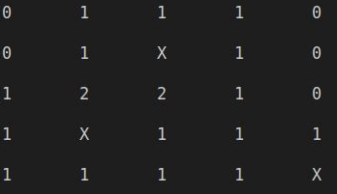
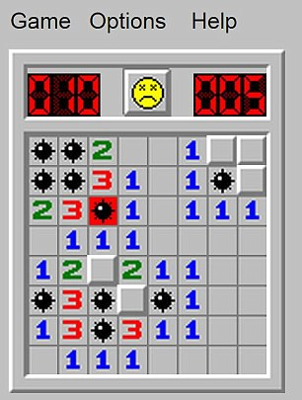
Trey Pollock: Minesweeper
The purpose is to reveal all numbers on the grid without revealing a bomb, aka "X".
Revealed numbers indicate how many bomb(s) are bordering the number.
How to play:
Select an x coordinate
Select a y coordinate
If you reveal a number, analyze and repeat until victory or game over.
Code for Minesweeper
Uh Oh…. Bombs away!

